Slide 1
Process Control
Course II
Lecture 11
Process Control Loops
Part I
By
Prof. Alaa Kareem Mohammed

Slide 2
Outline
1- Project Diagrams
2- Basic control Loop
3- Tag descriptor
4 - Line symbols
5- Instrument Location
6- Instrumentation Numbering

Slide 3
1- Project Diagrams
Piping & Instrumentation Diagram
PID
Process Flow Diagram
PFD
Block Diagram
BD

Slide 4
Block Diagram BD
Mixed Gas 2610 kg/hr
Toluene, C₇H₈ 10,000 kg/hr
Reactor
Gas Separator
C₆H₆
CH₄
C₇H₈
Benzene, C₆H₆ 8,210 kg/hr
Hydrogen H₂ 820 kg/hr
Mixed Liquid
75% Conversion of Toluene
$$C_{7}H_{8}+H_{2} → C_{6}H_{6}+CH_{4}$$

Slide 5
Process Flow Diagram PFD
Hot water out
E-100
Condenser
P-101
Pump
R-101
Reactor
R-100
Reactor
P-100
Pump
T-100
Distillation Column
Ethylene
Ethylene liq.
E-100
6
V-104
Cold water in
T-100
V-106
25
CV-100
CV-101
28
V-105
Ethanol
5
20
1
V-101
V-102
H₂SO₄
4
Hydrogen
V-100
38
9
R-100
V-103
V-107
Ni
3
R-101
Ethane
2
35
8
10
35
31.0
7
H₂O
32.2
P-101
P-100
Stream Number | 1 | 2 | 3 | 4 | 5 | 6 | 7 | 8 | 9 | 10
Temperature (ºC) | 25.0 | 35.0 | 35.0 | 35.0 | 35.0 | 60.3 | 41 | 38 | 54 | 45.1
Pressure (psi) | 28 | 32.2 | 31.0 | 31.0 | 30.2 | 45.1 | 31.3 | 24.0 | 39 | 2.6
Vapor fraction
Mass flow (tonne/hr) | 10.3 | 13.3 | 0.82 | 20.5 | 6.41 | 20.5 | 0.36 | 9.2 | 20.9 | 11.6
Mole flow (kmol/hr) | 108 | 114.2 | 301.0 | 1204.0 | 758.8 | 1204.4 | 42.6 | 1100.8 | 142.2 | 244.0

Slide 6
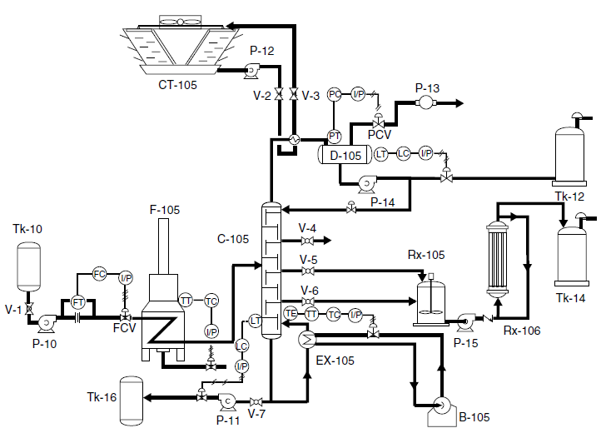
Piping & Instrumentation Diagram PID

Slide 7
2- Basic Control Loop
Consider the continuous stirred tank heater CSTH which shown below. We wish to maintain the outlet stream at a certain temperature value To. The system contains the control loop which consists of the following elements:
1- Temperature measuring element.
2- Temperature transmitter.
3- Temperature controller.
4- Control valve.
m
cp
T_{i}
M
Process
m
cp
T_{o}
Q
T T
Tc
Set point
Steam in

Slide 8
In general , the basic loop consists of the following element that shown in Figure below.
Process
Sensing Element
Final Control
Element
Measuring
Element
Transmitter
Transmit
Element
Control Element

Slide 9
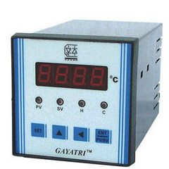
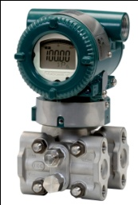
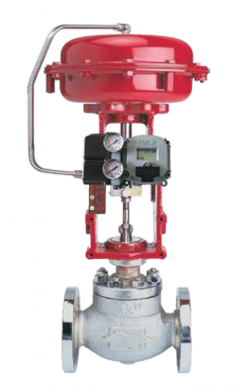
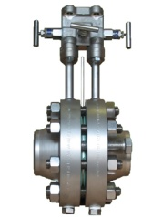
Set point
Set point
Controller
F T
FIC
Transmitter
Control valve
F E
Fluid
Fluid
C V
Orifice
(Flow Sensor)

Slide 10
m
cp
T_{i}
m
cp
T_{i}
m
cp
T_{i}
m
cp
T_{o}
m
cp
T_{o}
M
M
Process
m
cp
T_{o}
Process
M
Process
T E
T E
Q
T T
Q
Q
T T
T T
Tc
Set point
TC
TR
Steam in
TRC
Steam in
Steam in
Set point
Set point

Slide 11
3- Tag descriptor
The tag descriptor may be written as :
or
X Z
X Y Z
Where:
X refers to variable
Y refers to function
Z refers to instrument
Z
X
Y
Instrument | Symbol
Indicator | I
recorder | R
Controller | C
Transmitter | T
Switch | S
Valve | V
Element | E
Alarm | A
Variable | Symbol
Temperature | T
Pressure | P
Flow | F
Level | L
Acidity | pH
Function | Symbol
Recording | R
Indicating | I
Control | C
Deferential | D
TI
FRC
LS
pH E
PCV
Temperature Indicator
Flow Recording Controller
Level switch
pH Element
Pressure Control Valve

Slide 12
Temperature
TI
Temperature Indicator
TRC
Temperature recording Controller
TR
Temperature Recorder
TCV
Temperature Control valve
TC
Temperature Controller
TA
Temperature Alarm
TT
Temperature Transmitter
TE
Temperature Element
TS
Temperature Switch
TIC
Temperature indicating Controller

Slide 13
Flow
FI
Flow Indicator
FRC
Flow recording Controller
FR
Flow Recorder
FCV
Flow Control valve
FC
Flow Controller
FA
Flow Alarm
FT
Flow Transmitter
FE
Flow Element
FS
Flow Switch
FIC
Flow indicating Controller

Slide 14
Pressure
PI
Pressure Indicator
PRC
Pressure recording Controller
PR
Pressure Recorder
PCV
Pressure Control valve
PC
Pressure Controller
PA
Pressure Alarm
PT
Pressure Transmitter
PE
Pressure Element
PS
Pressure Switch
PIC
Pressure indicating Controller

Slide 15
Level
LI
Level Indicator
LRC
Level recording Controller
LR
Level Recorder
LCV
Level Control valve
LC
Level Controller
LA
Level Alarm
LT
Level Transmitter
LE
Level Element
LS
Level Switch
LIC
Level indicating Controller

Slide 16
4- Line symbols
Process Connection
Electrical Signal
Pneumatic signal
Hydraulics signal
Data link
Electromagnetic or
sonic signal
Capillary tube

Slide 17
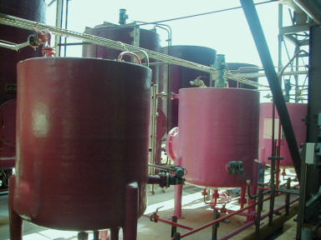
5- Instrument Location
- Instruments that are mounted on the equipment or in the pipe network.
(i.e. sensor that mounted on pipeline or process equipment.)
Field mounted on pipeline

Slide 18
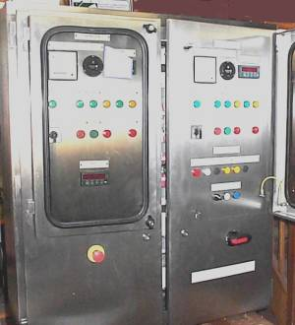
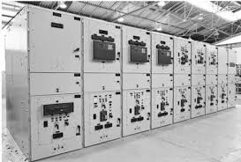
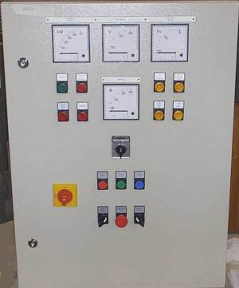
Instrument that located on central control panel.
Front mounted ( visible to the operator)

Slide 19
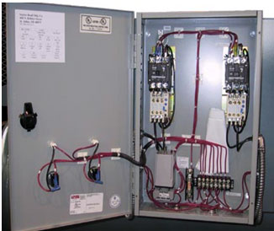
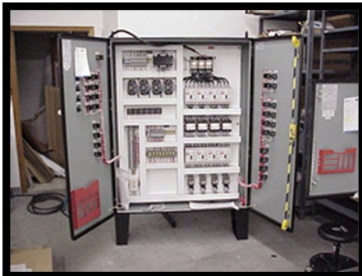
- Instrument that located on central control panel.
- Rear mounted (invisible to the operator. Instruments that are mounted behind a control panel board.

Slide 20
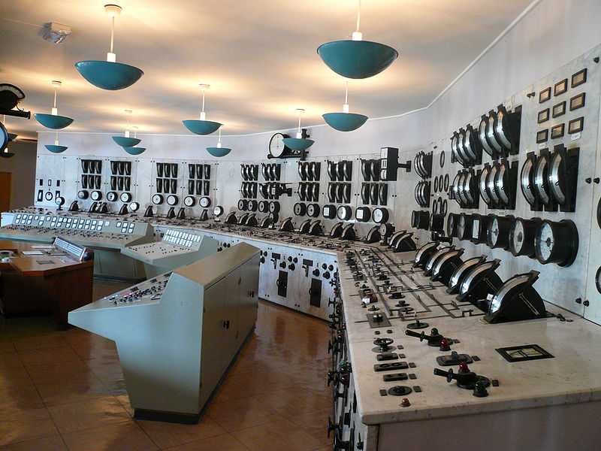
Shared instrument that located on central control panel shared in Distributed Control System (DCS)
- The entire system of controllers is connected by networks for communication and monitoring.

Slide 21
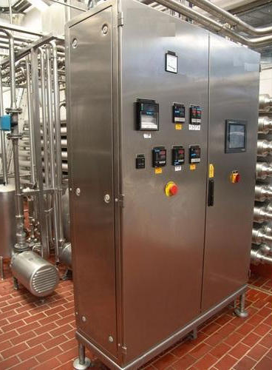
- The instrument is mounted on the local control panel near the equipment,
- Front mounted (visible to the operator).

Slide 22
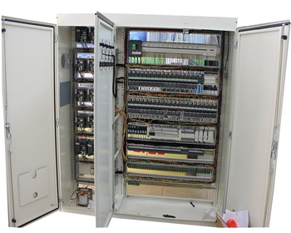
- The instrument is mounted on the local control panel near the equipment,
- Rear mounted (invisible to the operator).

Slide 23
Field mounted
The instrument is mounted on the equipment or on the pipe.
Main control panel front-mounted.
The instrument is mounted in the remote panel, visible to the operator
Main control panel rear-mounted.
The instrument is mounted in the remote panel, invisible to the operator( behind the panel)
Auxiliary control panel front –mounted.
The instrument is mounted on the local panel near the equipment, visible to the operator.
Auxiliary control panel rear - mounted
The instrument is mounted on the local panel near the equipment, invisible to the operator( behind the panel).
Main control panel front-mounted.
Shared instrument is mounted in the remote panel, visible to the operator

Slide 24
Example 1
LRC
LI
LT
Describe the control instrument in the diagram below.
m , T1
LE
H
m , T2
Q
T E
Steam in
Set point
T I
TR
Tc

Slide 25
6- Instrument Numbering
XYZ NRR LL
Where:
X refers to variable. T=Temperature, P = Pressure ……etc.
Y refers to function. R = Recording, I = Indicating………etc.
Z refers to instrument. C =Controller. E= Element ………etc.
NRR : Number of instrument
N : Zone No. in the plant.
LL : Control loop No.
Temperature Recording Controller
No.: 105
Zone :1
Loop No. : 20
For example
TRC
10520

Slide 26
Exercise
Describe the following instruments
PIC
34510
LS
255 30
FA
45115
TS
20916

Slide 27
Example 2
Consider the storage tank T-101 shown below. Construct a control loop according to the following specification:
1- Level element
2- Level transmitter
3- Level indicator: located on remote control panel (visible)
4- Level recording controller. (function in DCS)
5- Pneumatic control valve
6- Zone No. =2
7- loop No. 4
7- Label each instrument with a number 16.
q1
T-101
R
h
q2

Slide 28
Solution
LRC
21604
q₁
LI
21604
L T
21604
L E
21604
h
q₂
R

Slide 29
Example 3
Consider the pressurized vessel (V-101) below. Draw control loop to show that the solenoid valve SV-100 will be activated to relief pressure when the pressure in the V-101 is higher than the desired value. Use the following instruments
1- Pressure element locally mounted.
2- Pressure transmitter locally mounted.
3- Pressure indicating controller that is function in DCS.
3- Suggest numbers for instruments.
S
Relief gas
F2
SV -100
F1
V-101
Gas inlet

Slide 30
Solution
P IC
10307
S
Relief gas
P T
F2
10307
SV -100
P E
10307
F1
V-101
Gas inlet

Slide 31
Example 4
Base tank
Acid tank
The diagram below shows pH adjustment.
We want to keep the solution in the tank TK-100 at pH=6.
When pH of the solution reduced below 6, Solenoid valve SV-101 will be opened to dosing NaOH to the tank TK-100.
When the pH become higher than 6, SV-102 will be opened to dosing H₂SO4 to the tank TK-100.
Use two control loops, each loop contains element, transmitter , indicating controller (mounted on local panel)
TK-102
TK-101
NaOH
H₂SO4
S
SV-101
S
SV-102
F1
Inlet solution
TK-100
outlet solution
F2
(pH adjustment tank)

Slide 32
Solution
Base tank
Acid tank
TK-102
TK-101
NaOH
H₂SO4
S
SV-101
S
SV-102
pHIC
pHIC
10706
F1
10807
Inlet solution
pHT
pHE
pHE
pHT
10706
10706
10807
10807
TK-100
F2
outlet solution
(pH adjustment tank)

Slide 33
Homework
Consider the system below which consists of two liquid- level tanks connected in series. The two levels h1 and h2 are to be controlled.
Draw two control loops, each one consists of Element, transmitter , indicator (local panel) and level recording controller (function in DCS).
Give a number for each loop.
q_{o}
LCV101
h1
q₁
TK101
LCV102
q₂
h2
TK102

Slide 34
Thank you
Any ?

